Slide 1
Automation
‘in’ Testing
--------
Beyond Test Automation

Slide 2







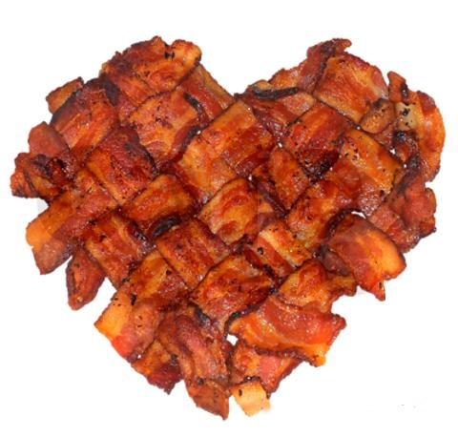
http://thefriendlytester.co.uk
@FriendlyTester
CDT
#MEWT
#WinTest

Slide 3
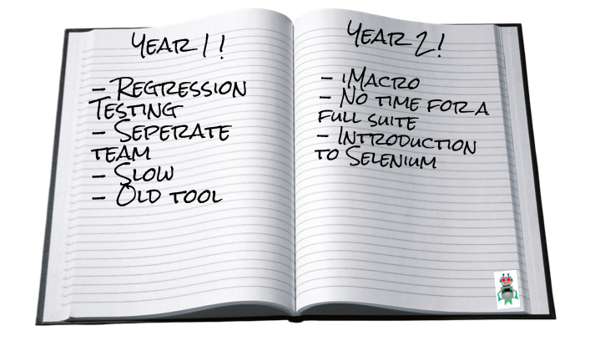


Slide 4
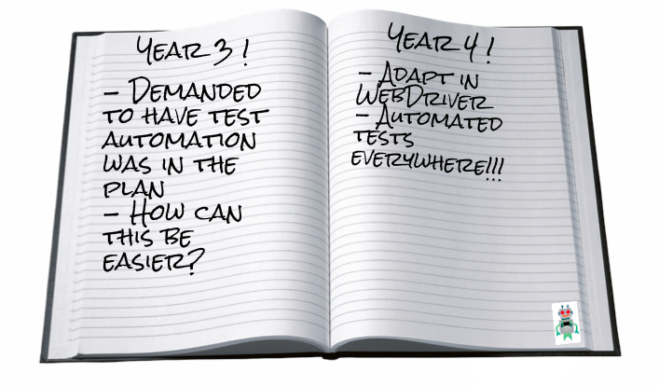

Slide 5
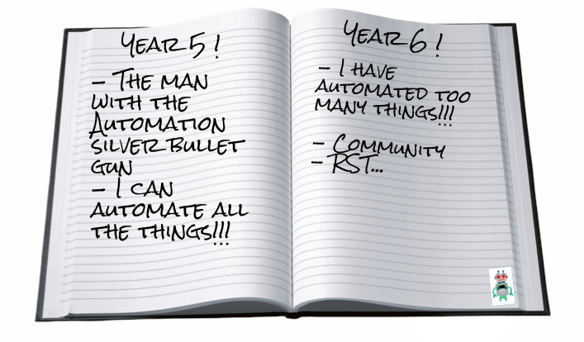


Slide 6
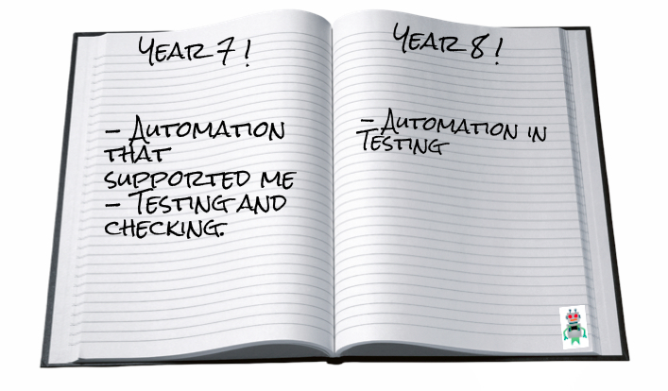

Slide 7

http://supplychaininsightsglobalsummit.com/three-paradigm-shifts-that-will-shape-future-supply-chains/

Slide 8
Testing is the process of evaluating a product by learning about it through exploration and experimentation, which includes to some degree: questioning, study, modeling, observation, inference, etc.
(A test is an instance of testing.)
http://www.satisfice.com/blog/archives/856

Slide 9
Checking is the process of making evaluations by applying algorithmic decision rules to specific observations of a product.
(A check is an instance of checking.)
http://www.satisfice.com/blog/archives/856

Slide 10
Test Automation
In software testing, test automation is the use of special software (separate from the software being tested) to control the execution of tests and the comparison of actual outcomes with predicted outcomes.
Wikipedia, http://en.wikipedia.org/wiki/Test_automation
The use of software to perform or support test activities, e.g. test management, test design, test execution and results checking.
ISTQB Glossary v2.4
Any use of hardware or software tools to support testing.
James Bach / Michael Bolton, Personal Communication

Slide 11
“It’s all too easy not to notice important differences if you label two things the same, or to see a difference where none exists if you label them differently”
Jerry Weinberg

Slide 12
What does it mean to you?
How do people talk about Test Automation at your organization?

Slide 13
naccurate
unnel
vision
What is Test Automation?
Check
arnished
Notes:
Automation in Testing positives

Slide 14
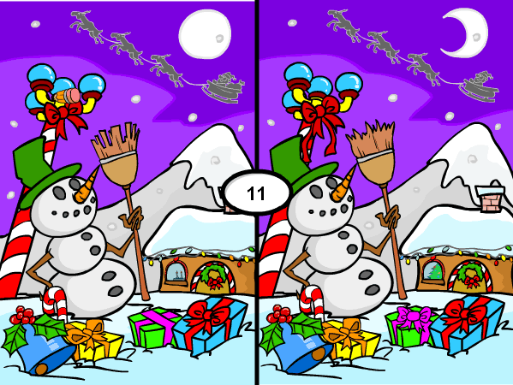

Slide 15


Slide 16
This doesn’t mean everything is OK, it means no change detected.

Slide 17
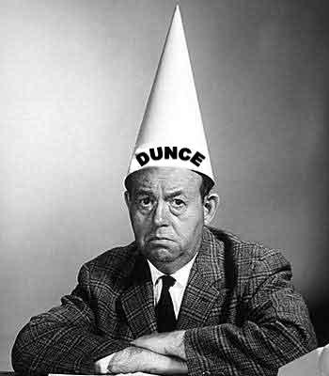

Slide 18
pportunties
ducation
Automation in Testing
nclusive
upports

Slide 19
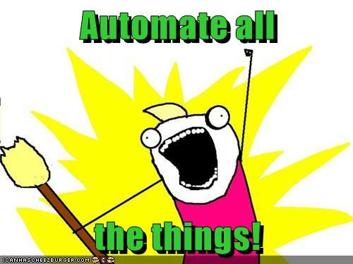
where value will be added
Notes:
Automate all the things that add value

Slide 20


Slide 21


Slide 22
Opportunities
Monitoring
Deployment
Log files
Log parser
Step to..
Data Getters
Data Management
Skypebot
Automated checks
Virtual Machines
Docker
App Deployment

Slide 23

http://www.leggetter.co.uk/2013/03/29/how-i-won-the-esri-devsummit-100-lines-of-javascript-competition.html

Slide 24
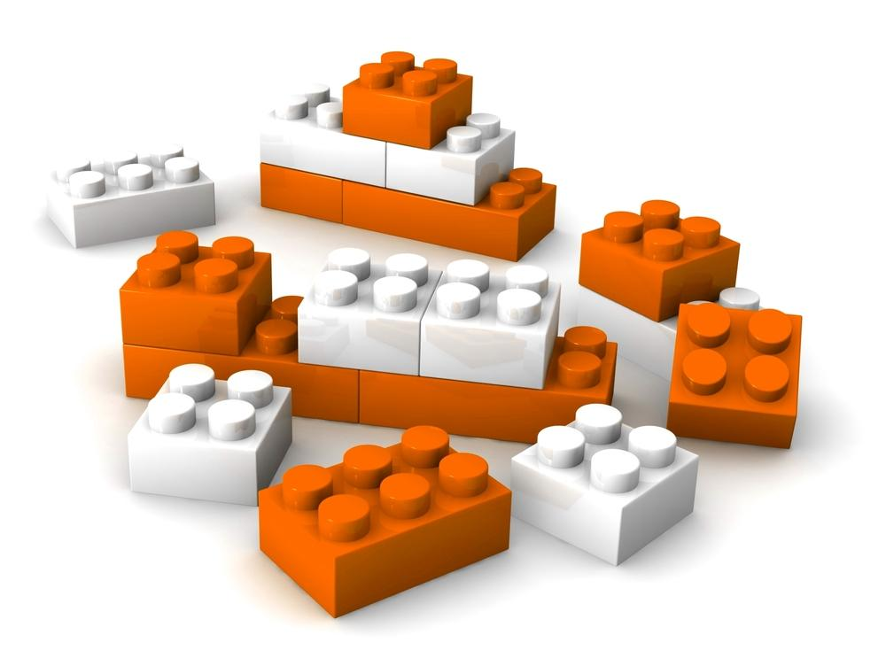

Slide 25
Automate
Automated
@eviltester

Slide 26
Educate
Puts the focus on your testing skills, and how such tools have supported you.
Testing and Checking, acknowledge the difference.
“It doesn’t have to be this way.”
Jerry Weinberg

Slide 27
The way we talk and think about automation needs to change. We need to remember it’s the testing problem we are trying to solve, not the “we need automation problem”. Think critically about your testing problem, and use tools where best appropriate, and acknowledge their limits.

Slide 28
